Slide 1
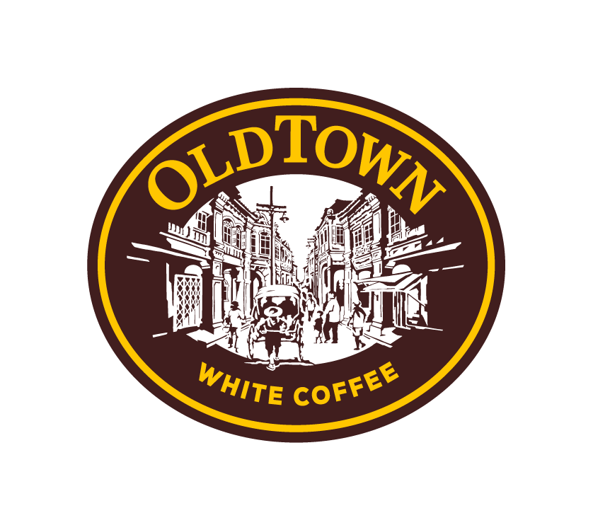
Old Town White Coffee
Our Key Recommendations
PT UCD BBS69 Group 7
Fariz Irwan Bin Joanis (26166447)
Dion Long De En (26159611)
Ratchumari Suhith (26170521)
Joshua Brian Khoo Kay Vinn (26142397)
Samrudhi Ekhande ()

Slide 2
Gaps & Competitors
1
PRESENTER
FARIZ

Slide 3






Strategic Partnerships come at a cost
OldTown White Coffee customer insights are fragmented from third parties
Luckin’s Coffee
Starbucks Coffee
Shopee
(Online Marketplace Transaction Data)
Grab
(Delivery Transaction Data)
Tabsquare
(Cafe Ordering Data )
Owned Digital Ecosystem
Notes:
OldTown White Coffee customer insights are fragmented
Imagine the same customer:
Orders breakfast at an OldTown café through TabSquare QR code, Orders coffee through Grab the following week, Buys OldTown 3-in-1 coffee sachets through Shopee, Returns to another outlet a month later
OldTown already reaches customers through cafés, delivery platforms and online marketplaces. But without an owned system, these will appear as four separate transactions instead of one complete customer relationship.
OldTown may not easily know that they came from the same customer, how to personalise which products the customer prefers, how frequent they would buy and which promotion could bring them back.
This weakens OldTown’s overall ability to build loyalty and personalise its marketing to suit customers needs.
Meanwhile, competitors such as starbucks and luckin have their own customer ecosystem apps which are connected through loyalty memberships, personalised customer profiles for promotions and data driven product testing

Slide 4
Comparison of Competitor’s Model
Luckin’s four core pillars of success behind 82 stores in Singapore
Small Footprint Stores 20-60 sqm pick up format (minimal capital expenditure) | Cashless Ordering 100% orders on app, No cashiers | Proven Franchise Grab and go model, Low initial setup cost for franchisees | Data-driven Product Strategy Use real time sales data for swift product decisions
Full dine in outlets Suntec self ordering kiosk never scaled | No official brand app No first-party transaction data | New formats are not data-validated Risk passed to franchisees | No first-party data Product cycle led by marketing not data
Luckin Scaling Model
Gaps
Notes:
Lets dive into luckin’s scaling model as luckin heavily relies on technology and AI
Mention the top main points of luckin scaling model (dont need mention all the details)
The bottom are OTWC gaps in comparison to luckin

Slide 5
Recommendation 1:
OTWC app
2
PRESENTER
DION & SUHITH

Slide 6
Old Town White Coffee App
RECOMMENDATION 1 · INCREASE REVENUE & IMPROVE CUSTOMER EXPERIENCE
Introducing..
Welcome Back, Dion!
Member ID:
dionlong
Password:
**********

Slide 7
Order System
FEATURE 1 · ORDERING
Unifies dine-in, pick-up, takeaway, and delivery into one ordering flow with full control of what customers experience
9:41
100%
Menu
Combined Menu search
Search menu...
One catalogue across cafe, FMCG, and delivery items
All
Coffee
Toast
In-app cart & checkout
Signature White Coffee
Replaces counter payment, every order becomes owned data
SGD 4.50
In-app promotions & marketing
Kaya Butter Toast Set
Personalised discounts (e.g. welcome back discount, rainy day discount, “We miss you” discounts), market new products
SGD 6.80
Iced Hazelnut Latte
Order history feeds AI
3 items
View Cart — SGD 15.50
RM 6.20
Purchase pattern data for upselling (personalised recommendations)
Home
Pulse
Outlets
Account
Replaces: TabSquare reliance for ordering + counter payment
Promotes: User experience with convenience and upselling through personalised recommendations

Slide 8
Store Locator & Order Pick Ups
FEATURE 2 · LOCATIONS
Guides customers on outlets near them, promote sales when customer is near an outlet
9:41
100%
Nearby Outlets
Identify when customers are near an outlet
Triggers push notification to encourage advance order
📍
Customer places order ahead of time
📍 You are here
Kallang Wave Mall
Customers proceed to store and pick up their order (shorten waiting time)
0.4 km · Halal
Square 2, Novena
Improves: User experience in finding stores near them, encourages online order and pick up
1.2 km · Open
Home
Pulse
Outlets
Account
Jurong Point

Slide 9
Coffee Subscription Programme
FEATURE 3 · SUBSCRIPTION
Recurring, direct-to-consumer sachet delivery.
9:41
100%
Subscription
Recurring, not one-off
Never run out at home
Converts Shopee/Lazada browsing into predictable monthly revenue
Save 15% on every delivery
Bypasses marketplace fees
YOUR SACHETS
Direct-to-consumer delivery skips Shopee/Lazada commissions
Classic White Coffee
x2 boxes
Hazelnut White Coffee
Value over lock-in
x1 box
5% subscriber discount on FMCG coffee sachets purchases
Gula Melaka Cold Brew*
x1 box
*Kopi Pulse winner — subscriber exclusive
Inspired by: Nespresso's subscribe-and-save model, adapted for OTWC's sachet range
Subscribe — SGD 18.90/mo
DELIVERY FREQUENCY
2 wks
Monthly
6 wks
Home
Pulse
Outlets
Account

Slide 10
Member Account
FEATURE 4 · LOYALTY
Closes the loyalty loop: every visit, not just app orders, now counts.
9:41
100%
Tiered membership
Dion L.
Classic → Gold → Platinum, unlocked by spending (driving up higher spend per customer)
Gold Tier
1,240
Visit streaks
Redeem
Rewards consecutive visits e.g. habitual morning customers (increasing repeat purchase)
points balance
260 pts to Platinum
Birthday & milestone rewards
7-day visit streak
Personalised offers triggered automatically by account data (building brand loyalty & stickiness)
Free Kaya Toast
Replaces: Fragmented stamp card
Encourages: Brand Loyalty and repeated purchases with points system
SGD2 Off Birthday Treat
MY REWARDS
Home
Pulse
Outlets
Account
Notes:
So this part of the app focuses on improving customer experience and brand loyalty.
Can mention the bolded parts and read of slide basically HAHA

Slide 11

Kopi Pulse (New products)
FEATURE 5 · PRODUCT TESTING
Turns product testing into a live, shareable customer experience.
9:41
100%
Live leaderboard voting
Kopi Pulse
Customers pre-order experimental items; sales data ranks them
This Week's Pulse
Generate virality and demand for new products
Vote before Sunday 11:59pm
Create social engagement with customers and generate hype for upcoming products
#1 Gula Melaka Cold Brew
Pre-order
Insights for menu changes
Top favourites may be in the full/seasonal menu
#2 Salted Egg Kaya Toast
Pre-order
Replaces: No product-testing capability
Introduces: New products and revenue stream
#3 Yuzu White Coffee
Pre-order
Home
Pulse
Outlets
Account
Notes:
As OTWC have no product testing capabilities, we would like to introduce kopi pulse
Kopi pulse is a product testing feature which allows customers to vote for a new beverage and the highest voted drink will be made available in store
Then read off slides

Slide 12
Old Town White Coffee App
RECOMMENDATION 1 · INCREASE REVENUE & IMPROVE CUSTOMER EXPERIENCE
Increases Revenue through..
Data informed upselling
Location prompts
Loyalty rewards
Subscription programme
Welcome Back, Dion!
Member ID:
dionlong
Improves Customer experience via..
Password:
**********
Gamified engagement
Faster and easier ordering
Personalised and relevant discounts
Loyalty programme
Shareable social experience

Slide 13
Recommendation 2:
Express Kiosks
3
PRESENTER
JOSHUA

Slide 14
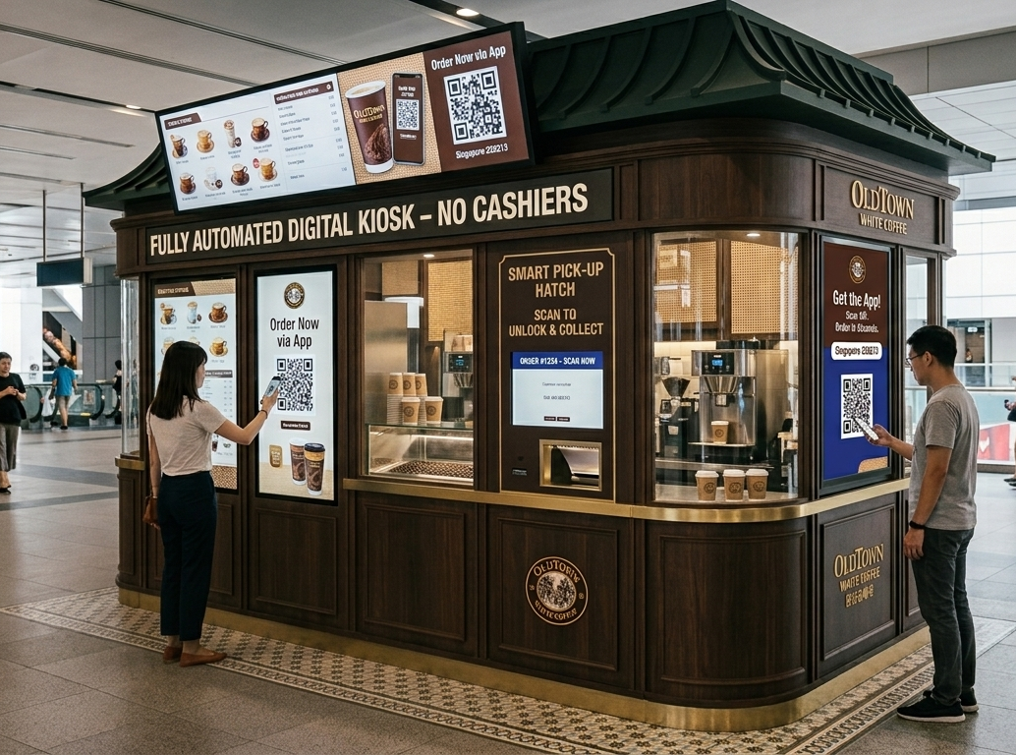
Kopi Express
RECOMMENDATION 2 · COST SAVINGS
A heritage-styled micro-kiosk: self-ordering, no cashier, linked to OTWC app for demand data
Lower set up cost
Full Dine-In Outlet: RM 600K-800K
Kopi Express: a fraction of the cost
Smaller space required for kiosks, reducing rental cost
No cashier
Self-order kiosks and app order cuts labour cost
AI Generated image (Google Gemini, 2026)
Data forecasts demand
Data collected from orders made digitally can help forecast demand and cut food waste
Reduces: Capital and operating expenditure (CAPEX and OPEX)

Slide 15
Conclusion:
How it all comes together as one system
4
PRESENTER
SAM

Slide 16



One system, three wins.
App generates the data that powers Kopi Express and the loyalty program
-30 to 40%* In food wastage
(demand forecasting)
App
+15%* Revenue uplift
(personalisation)
owned data
+30-50%* Visit frequency
(loyalty members)
Loyalty Programme
Kopi Express (Kiosk)
Brand stickiness
efficient formats
*Values are based on real world estimates of similar initiatives
Notes:
GeekyAnts. (2025). AI demand forecasting for restaurants: Cut food waste and boost margins. https://geekyants.com/blog/ai-demand-forecasting-for-restaurants-cut-food-waste-boost-margins
Jobaaj Learnings. (2025). Starbucks Rewards: A global loyalty ecosystem case study. https://www.jobaajlearnings.com/casestudies/Starbucks-Rewards-A-Global-Loyalty-Ecosystem-Case-Study
GoSnappy.io. (2024). 10 ways AI can help your restaurant increase margins. https://gosnappy.io/blog/ways-ai-can-help-your-restaurant/

Slide 17
Thank you!

Slide 18
References
The Edge Singapore. (2019). Don't know what to eat? Let TabSquare personalise your menu. Yahoo Finance. https://sg.finance.yahoo.com/news/don-t-know-eat-let-091115470.html
Lazada Malaysia. (2025). OLDTOWN White Coffee Malaysia official online store. https://www.lazada.com.my/shop/oldtown-white-coffee/
Mini Me Insights. (2024, June 9). OLDTOWN White Coffee robotic chef and barista open for franchise. https://www.minimeinsights.com/2024/06/09/oldtown-white-coffee-robotic-chef-and-barista-open-for-franchise/
Vulcan Post. (2026). SGD 4 coffee, 81 stores: How is Luckin Coffee expanding rapidly in Singapore while keeping its coffee so cheap? https://vulcanpost.com/910825/luckin-coffee-singapore-expansion/
Inside Retail Asia. (2026, March 3). Luckin Coffee's 30,000-store moment: Can scale sustain China's coffee boom? https://insideretail.asia/2026/03/03/luckin-coffees-30000-store-moment-can-scale-sustain-chinas-coffee-boom/
Momentum Works. (2025). Luckin Coffee: Rise, fall, and reinvention – Part 4. https://thelowdown.momentum.asia/luckin-coffee-rise-fall-and-reinvention-part-4/
TabSquare. (n.d.). OldTown White Coffee chooses automation | Try TabSquare for your restaurant's success [Video]. YouTube. https://www.youtube.com/watch?v=zNAbk8IIpoI
BackScoop. (2024). OldTown White Coffee: The brand that introduced Malaysian white coffee to the world. https://www.backscoop.com/newsletter-posts/oldtown-white-coffee-the-brand-that-introduced-malaysian-white-coffee-to-the-world
GeekyAnts. (2025). AI demand forecasting for restaurants: Cut food waste and boost margins. https://geekyants.com/blog/ai-demand-forecasting-for-restaurants-cut-food-waste-boost-margins
Jobaaj Learnings. (2025). Starbucks Rewards: A global loyalty ecosystem case study. https://www.jobaajlearnings.com/casestudies/Starbucks-Rewards-A-Global-Loyalty-Ecosystem-Case-Study
GoSnappy.io. (2024). 10 ways AI can help your restaurant increase margins. https://gosnappy.io/blog/ways-ai-can-help-your-restaurant/
Google Gemini. (2026). Digital micro-kiosk design for Old Town White Coffee inspired by Luckin Coffee [AI-generated image]. https://gemini.google.com

